Slide 1
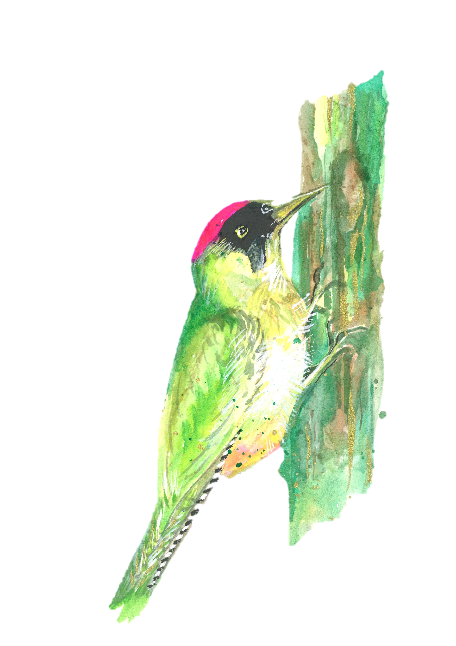
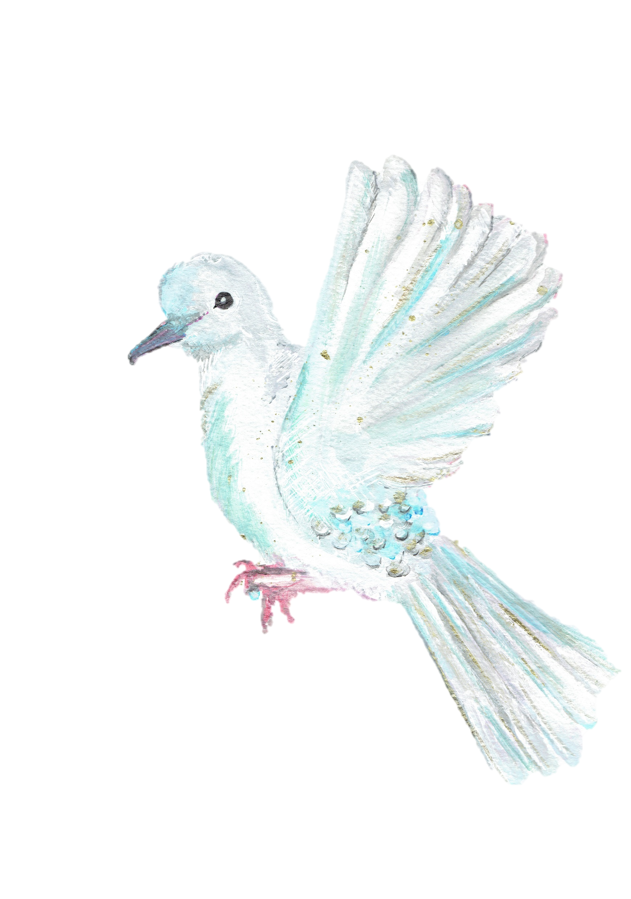
Welcome to Year 3
Woodpeckers
Miss McGuckian
Mrs Kelly
Mrs Craig
Doves
Mrs Hayman
Mrs Hall
Mrs Kitson

Slide 2
School Timings
Start of school:
Gates open at 8:30am and bell rings at 8:45am. All children must be in class by 8:45am
End of school:
School finishes at 3:15pm. Please collect from the playground area through the KS2 gate.

Slide 3
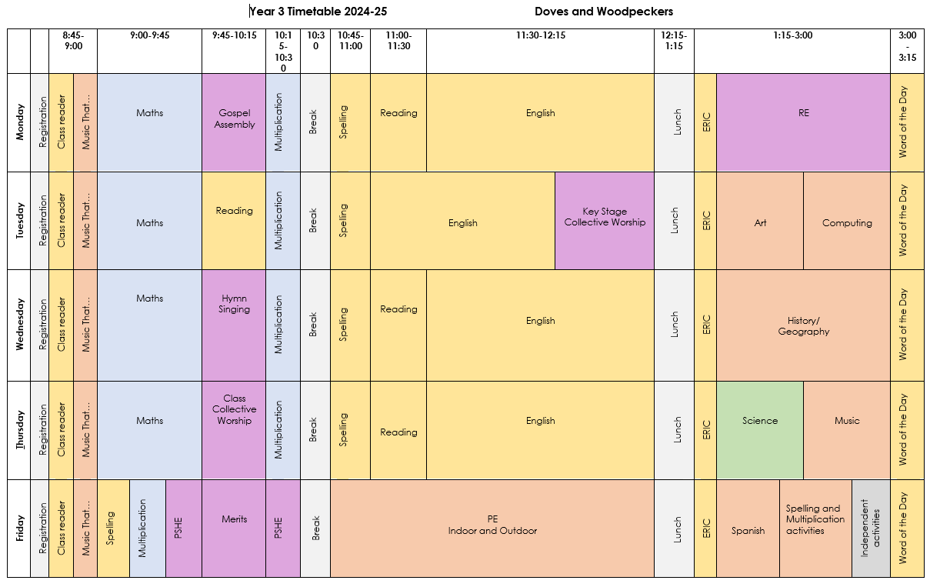
Timetable

Slide 4
Curriculum Information
Autumn Term
Stone Age to Iron Age - History
Rainforests - Geography
Spring Term
Ancient Egyptians - History
Where Does Our Food Come From? - Geography
Summer Term
Our Local Area - History
Rivers - Geography
All information can be found on the class pages of the school website.

Slide 5
Homework
Reading
15 minutes a day. Homework diaries and reading books need to be in school everyday. Please sign the homework diary when you have heard your child read.
Word of the Day
The children will write a word into their homework diary everyday. Find the meaning of the word at home and write the definition into homework diary. This will then be discussed in class.
Spellings and Times tables
Both of these are on the school website for the year. Daily practise at home and in school.
TT Rockstars
Daily practise of 10-15minutes.
If unsure of log in details, please ask your child’s teacher for the information.

Slide 6
PE Kits
The children need to be in their named PE kit on a Friday.
-Black shorts/tracksuit bottoms-no leggings
-White T-Shirt
-Black sweatshirt-no hoodies
-Plain black or white trainers
Water bottles and snacks
Children must have a named water bottle at school everyday.
Snacks need to be provided from home. These must be a fruit or vegetable based snack.

